Slide 1
Environmental Management Sem-VIII

Slide 2
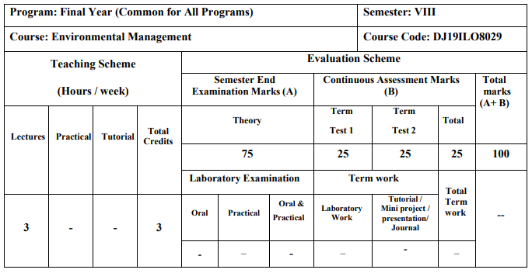
Schema & Syllabus

Slide 3
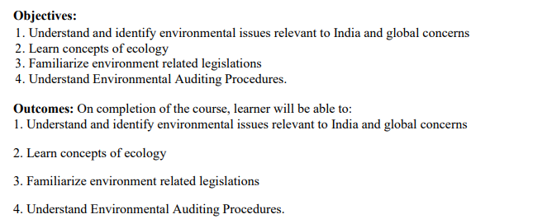
Objectives & Outcomes

Slide 4
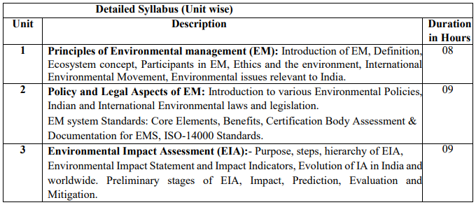
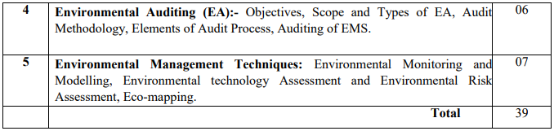
Syllabus

Slide 5
Module-1
Principles of Environmental Management (EM)
Contents:
Introduction of EM
Definition, Ecosystem concept
Participants in EM
Ethics and the environment
International Environmental Movement Environmental issues relevant to India

Slide 6
Introduction & Definition of Environment
Definition: Environment is the surroundings or control conditions in which all living organisms exist.
Our environment is everything that surrounds us, both natural and manmade.
Or the total sum of surroundings of living organism, including natural forces & other living things which provide conditions for development & growth as well as of danger & damage.
Or ENVIRONMENT: THE TOTAL OF OUR SURROUNDINGS • All the things around us with which we interact: • Living things • Animals, plants, forests, fungi, etc. • Nonliving things • Continents, oceans, clouds, soil, rocks • Our built environment • Buildings, human-created living centers • Social relationships and institutions
Thus the environment studies may vary from micro level to macro level.
Micro Level study: In case of some local studies such as ecosystem or solid waste management
Macro Level study: Global issues such as Green House Effect or Ozon depletion.

Slide 7
Types of pollutions: Air pollution, Water Pollution, Noise pollution, Land pollution
Pollution: It is deliberate or accidental contamination environment. Any manmade activity contributes to pollution with rapid urbanization & industrialization. There has been tremendous burden on natural resources.
→Every human kind must be aware about the pollution & types of pollutions.
→All the engineers are directly or indirectly have the greater concern about environment and its types. Engineers are the best dealer of the ways & means to overcome them.

Slide 8
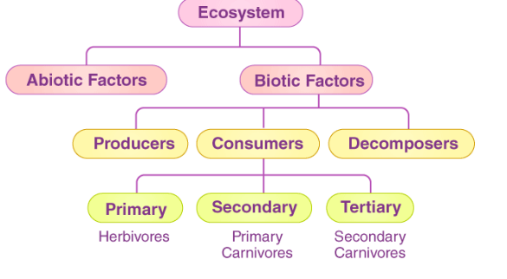
What is an Ecosystem?
An ecosystem is a structural and functional unit of ecology where the living organisms interact with each other and the surrounding environment. In other words, an ecosystem is a chain of interactions between organisms and their environment. The term “Ecosystem” was first coined by A.G.Tansley, an English botanist, in 1935.
Structure of the Ecosystem

Slide 9
Main Features of environment
Environment includes basically of living organisms (Biotic Factors) & nonliving factors (Abiotic factors) & their mutual interaction.
If proper balance between them then there is a healthy environment. (e.g. self sustaining ecosystem without the external interferences, especially man).
Due to unbalancing between above two factors a formation of environmental science is done, which is a part of environment. (degradation of environment)
(Unbalancing – e.g. when an industry discharges its waste in nearby water body, without proper treatment, there is an imbalance leading to degradation of environment & imbalanced ecology)

Slide 10
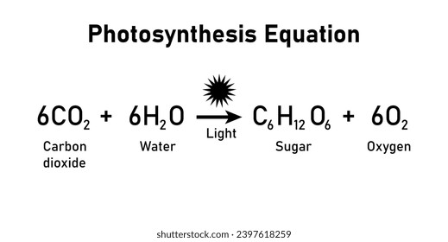
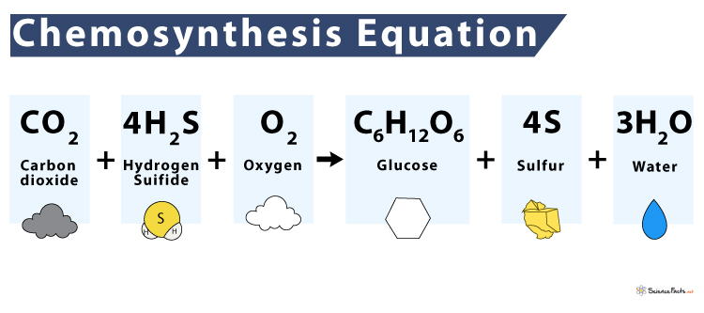
Biotic form (Any living part of an environment with which an organism might interact. Ex. Animals, plants, mushrooms, bacteria, etc. )
Autotrophs – Organisms that capture energy from sunlight or chemicals and convert it into forms, living cells can use.
Heterotrophs – can not make their own food; acquire energy from other organisms by ingesting (taking inside) them.
Producers – Make their own food.
Primary producers – the first producers of energy-rich compounds that are later used by other organisms.
→Autotrophs are primary producers!
→Most engage in the process of photosynthesis.
→Chemosynthesis – chemical energy is used to produce carbohydrates in dark conditions (like the deep oceans).

Slide 11
Consumers – organisms that rely on other organisms for energy and nutrients.
→Carnivores – kill and eat other animals.
→ Hunters – consume the bodies of dead animals.
Decomposers – chemically break down organic matter (bacteria and fungi are examples).
→Herbivores – eat plants.
→Omnivores – diets include both plant and animal matter.
→ Detritivores – feed on detritus (small pieces of decaying matter) by grinding them into smaller pieces (earthworms and snails are examples). Often digest the decomposers living on the detritus.

Slide 12
Abiotic factors (Nonliving part of the environment that influence the organism. Ex. Sunlight, heat, precipitation, humidity, wind, water current, soil type, etc.)
These factors mainly consist of non living part and can be broadly classified in following functional groups
Climatic factors: rainfall, light, temperature, atmospheric humidity & wind.
Physiographic factors:
→Factors that have their origin in the form, behavior
& structure of earth surface
→ Physical & chemical constituents of the soil(sandy, clayey), Presence of rivers, lakes, and seas, Groundwater availability , such as its structure, chemical properties etc.

Slide 13
Functions of Ecosystem
The functions of the ecosystem are as follows:
It regulates the essential ecological processes, supports life systems and renders stability.
It is also responsible for the cycling of nutrients between biotic and abiotic components.
It maintains a balance among the various trophic levels in the ecosystem.
It cycles the minerals through the biosphere.
The abiotic components help in the synthesis of organic components that involve the exchange of energy.

Slide 14
Types of Ecosystem
An ecosystem can be as small as an oasis in a desert, or as big as an ocean, spanning thousands of miles. There are two types of ecosystem:
Terrestrial Ecosystem
Aquatic Ecosystem

Slide 15
Terrestrial Ecosystem
Terrestrial ecosystems are exclusively land-based ecosystems. There are different types of terrestrial ecosystems distributed around various geological zones. They are as follows:
Forest Ecosystem
Grassland Ecosystem
Tundra Ecosystem
Desert Ecosystem
Forest Ecosystem :A forest ecosystem consists of several plants, particularly trees, animals and microorganisms that live in coordination with the abiotic factors of the environment. Forests help in maintaining the temperature of the earth and are the major carbon sink.
Grassland Ecosystem : In a grassland ecosystem, the plant is dominated by grasses and herbs. Temperate grasslands and tropical or savanna grasslands are examples of grassland ecosystems.
Tundra Ecosystem : Tundra ecosystems are lacking of trees and are found in cold climates or where rainfall is rare. These are covered with snow for most of the year. Tundra type of ecosystem is found in the Arctic or mountain tops.
Desert Ecosystem :Deserts are found throughout the world. These are regions with little rainfall and rare plants. The days are hot, and the nights are cold.

Slide 16
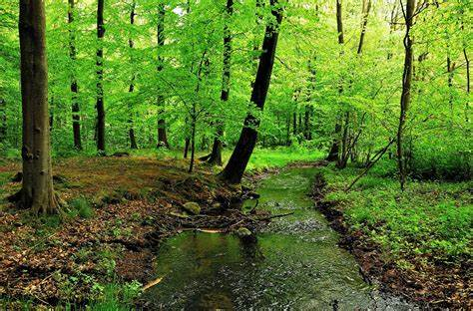

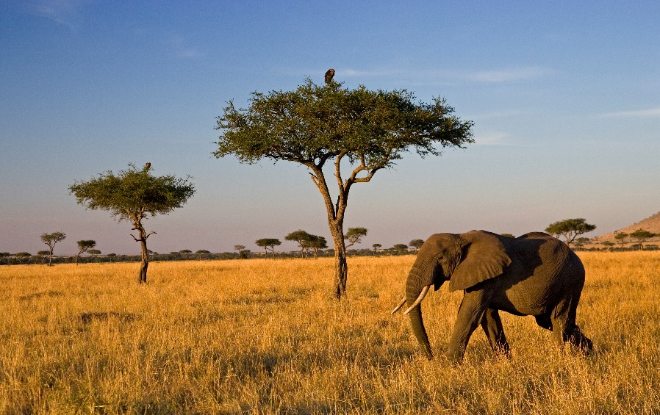

Terrestrial Ecosystems

Slide 17
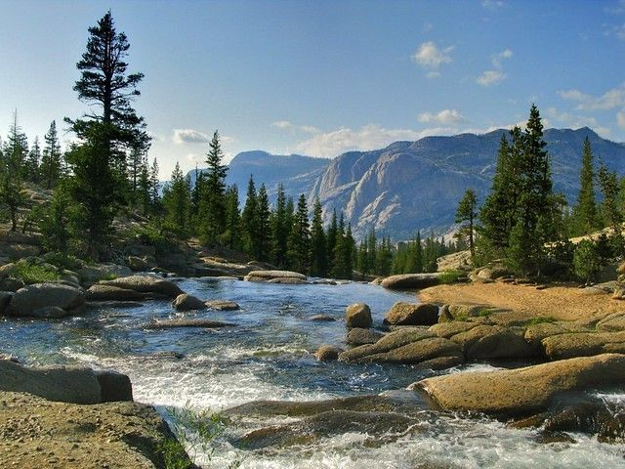
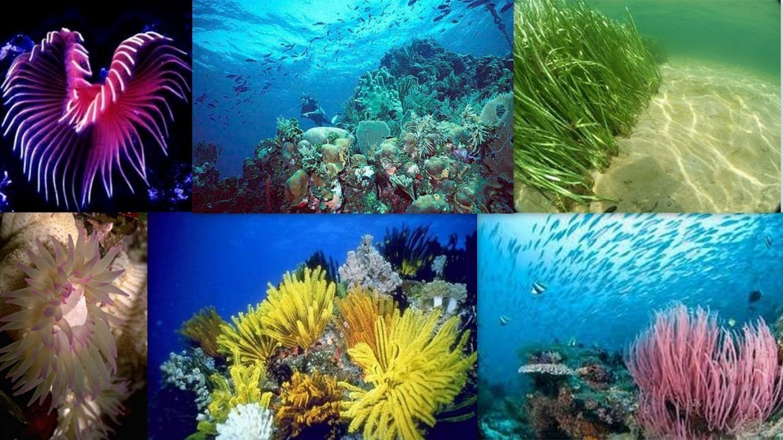
Aquatic Ecosystem
Aquatic ecosystems are ecosystems present in a body of water. These can be further divided into two types, namely:
Freshwater Ecosystem
Marine Ecosystem
Freshwater Ecosystem
The freshwater ecosystem is an aquatic ecosystem that includes lakes, ponds, rivers, streams and wetlands. These have no salt content in contrast with the marine ecosystem.
Marine Ecosystem
The marine ecosystem includes seas and oceans. These have a more substantial salt content and greater biodiversity in comparison to the freshwater ecosystem.

Slide 18
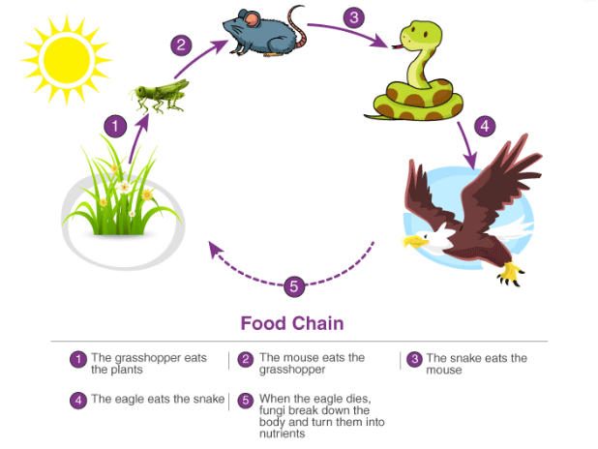
Important Ecological Concepts
1. Food Chain
The sun is the ultimate source of energy on earth. It provides the energy required for all plant life. The plants utilise this energy for the process of photosynthesis, which is used to synthesise their food.
During this biological process, light energy is converted into chemical energy and is passed on through successive trophic levels. The flow of energy from a producer, to a consumer and eventually, to an apex predator or a detritivore is called the food chain.
Dead and decaying matter, along with organic debris, is broken down into its constituents by scavengers. The reducers then absorb these constituents. After gaining the energy, the reducers liberate molecules to the environment, which can be utilised again by the producers.

Slide 19
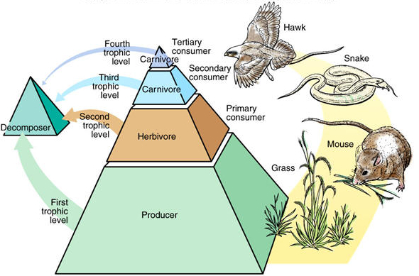
Important Ecological Concepts
2. Ecological Pyramids
An ecological pyramid is the graphical representation of the number, energy, and biomass of the successive trophic levels of an ecosystem. Charles Elton was the first ecologist to describe the ecological pyramid and its principals in 1927.
The biomass, number, and energy of organisms ranging from the producer level to the consumer level are represented in the form of a pyramid; hence, it is known as the ecological pyramid.

Slide 20
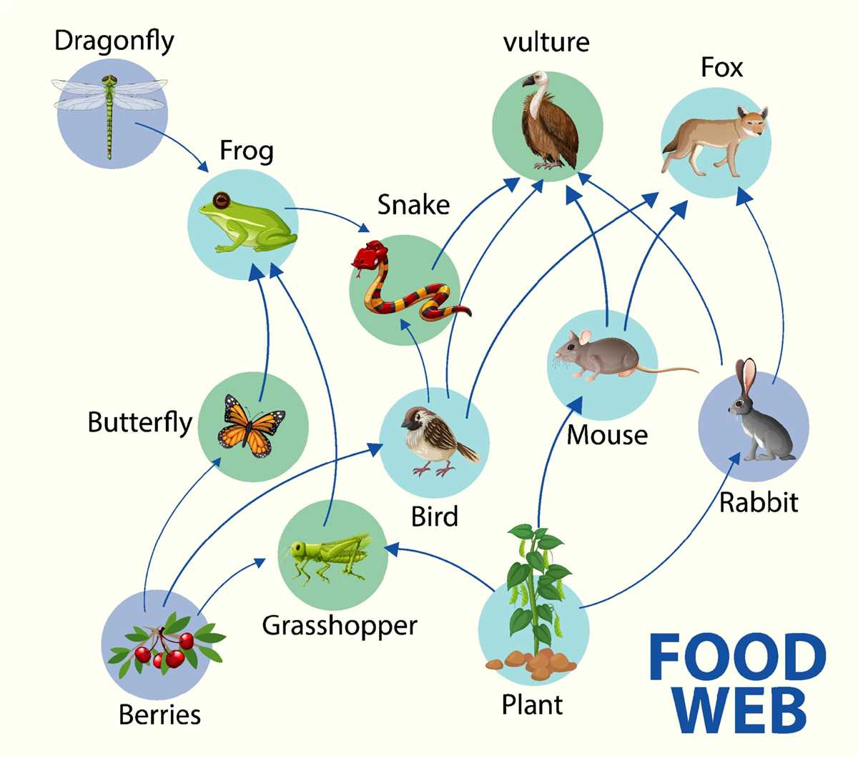
Important Ecological Concepts
3. Food Web
Food web is a network of interconnected food chains. It comprises all the food chains within a single ecosystem.
It helps in understanding that plants lay the foundation of all the food chains.

Slide 21
Participants in EM
Environmental Management (EM) involves multiple stakeholders who contribute to sustainability, conservation, and ecological protection.
These participants include governments, businesses, communities, and scientific organizations, each playing a unique role in environmental responsibility.

Slide 22
Participants in EM
1. Government & Regulatory Bodies 🏛️
Role: Formulate environmental laws, policies, and enforcement mechanisms.
Example:
United Nations Environment Programme (UNEP) – Develops global sustainability initiatives.
Environmental Protection Agency (EPA, USA) – Regulates pollution control and climate policies.
Ministry of Environment (India, China, EU, etc.) – Implements national environmental programs.
2. Corporations & Industries 🏭
Role: Adopt sustainable practices, reduce pollution, and integrate green supply chains.
Example:
Tesla – Innovates electric vehicles (EVs) to reduce carbon emissions.
Unilever – Uses renewable energy in production and promotes plastic waste reduction.
IKEA – Aims for a 100% circular economy by 2030 with sustainable sourcing.

Slide 23
Participants in EM
3. Non-Governmental Organizations (NGOs) 🌱
Role: Advocate for conservation, educate communities, and influence policies.
Example:
Greenpeace – Campaigns against deforestation, pollution, and climate change.
World Wildlife Fund (WWF) – Works on wildlife conservation and ecosystem restoration.
The Nature Conservancy – Focuses on protecting forests, oceans, and freshwater sources.
4. Scientists & Environmental Researchers 🔬
Role: Study climate change, develop eco-friendly technologies, and analyze pollution impacts.
Example:
NASA Climate Scientists – Monitor global warming trends using satellite data.
IPCC (Intergovernmental Panel on Climate Change) – Provides scientific reports on climate risks.
University Research Centers – Develop renewable energy solutions and sustainable agriculture techniques.

Slide 24
Participants in EM
5. Financial Institutions & Investors 💰
Role: Fund green projects, sustainable businesses, and renewable energy initiatives.
Example:
World Bank Green Bonds – Funds climate resilience projects in developing nations.
Sustainable Investment Funds – Encourage businesses to adopt ESG (Environmental, Social, Governance) practices.
Tesla’s Carbon Credit System – Allows companies to trade carbon credits for sustainability.
6. Consumers & General Public 👨‍👩‍👧‍👦
Role: Demand eco-friendly products, reduce waste, and support green businesses.
Example:
Zero-Waste Lifestyle – Consumers using reusable bags, composting, and reducing plastic.
Vegan & Plant-Based Diets – Reducing carbon footprint by consuming less meat.
Supporting Green Brands – Buying from companies with ethical environmental policies.

Slide 25
Participants in EM
7. Educational Institutions & Academics 🎓
Role: Teach sustainability, conduct research, and train future environmental leaders.
Example:
Harvard University’s Center for Climate, Health & Global Environment – Conducts climate research.
Schools Promoting Eco-Clubs – Encouraging students to participate in tree-planting and recycling.
Corporate Sustainability Training – Universities offering courses in environmental management.
8. Media & Environmental Activists 📢
Role: Spread awareness about climate issues, expose pollution, and push for policy changes.
Example:
Documentaries like "An Inconvenient Truth" (Al Gore) – Highlight climate change dangers.
Greta Thunberg’s Climate Movement – Youth activism for stronger climate policies.
National Geographic & BBC Earth – Educating the public on nature conservation.

Slide 26
Participants in EM
10. International Organizations & Agreements 🌎
Role: Facilitate global environmental policies, treaties, and cooperative projects.
Example:
Paris Climate Agreement – Countries committed to reducing greenhouse gas emissions.
United Nations Sustainable Development Goals (SDGs) – Promote sustainability worldwide.
COP28 (Conference of the Parties) – Global discussions on climate action.
Effective environmental management requires collaboration between governments, businesses, scientists, and communities. Everyone has a role to play in protecting the planet for future generations.

Slide 27
Significance of Environment Management for Contemporary/Modern Managers
Significance of Environmental Management with Examples
Environmental management refers to the systematic approach organizations and governments take to minimize environmental impact, preserve natural resources, and promote sustainable practices. Here are 10 significant aspects of environmental management, along with suitable examples:
1. Resource Conservation
Significance: Helps manage natural resources like water, energy, and raw materials efficiently to ensure their availability for future generations. Example: Coca-Cola India implemented a water stewardship program, focusing on water conservation, replenishment, and wastewater recycling to achieve water neutrality.

Slide 28
Following points shows the significance of EM:
2. Pollution Control
Significance: Reduces pollution from industrial, agricultural, and urban activities, protecting air, water, and soil quality. Example: The Delhi Metro Rail Corporation (DMRC) adopted CNG buses and solar panels, significantly reducing air pollution in the city.
3. Biodiversity Protection
Significance: Protects ecosystems and wildlife by preserving natural habitats and preventing deforestation and overexploitation. Example: The reforestation project in the Western Ghats of India helps restore biodiversity by planting native species and protecting endangered wildlife.

Slide 29
Following points shows the significance of EM:
4. Climate Change Mitigation
Significance: Reduces greenhouse gas emissions and promotes renewable energy to combat climate change. Example: Tata Power’s wind and solar farms contribute to India’s renewable energy goals, reducing dependence on fossil fuels.
5. Waste Management
Significance: Promotes the reduction, recycling, and proper disposal of waste to prevent land and water contamination. Example: ITC’s “Wow - Wealth Out of Waste” initiative encourages urban households to segregate and recycle waste.

Slide 30
Following points shows the significance of EM:
6. Compliance with Regulations
Significance: Ensures organizations adhere to environmental laws and avoid penalties while maintaining ethical standards. Example: Infosys adheres to India’s energy and emissions regulations by using green buildings and achieving carbon neutrality.
7. Sustainable Development
Significance: Balances economic growth with environmental protection to ensure long-term sustainability. Example: Suzlon Energy Limited develops wind energy solutions to provide sustainable power while preserving the environment.

Slide 31
Following points shows the significance of EM:
8. Risk Mitigation
Significance: Identifies and mitigates risks related to environmental disasters, accidents, or resource depletion. Example: The Chambal River Basin project focuses on preventing soil erosion and mitigating the risk of droughts in the region.
9. Corporate Social Responsibility (CSR)
Significance: Encourages companies to integrate environmental protection into their CSR initiatives, benefiting society. Example: Mahindra & Mahindra launched the “Lifeline for Tigers” program, contributing to tiger conservation and habitat restoration.

Slide 32
Following points shows the significance of EM:
10. Improved Public Health
Significance: Reduces environmental hazards like air and water pollution, leading to better health outcomes for communities. Example: Clean Ganga Mission (Namami Gange) focuses on cleaning the river Ganga, improving the health and well-being of millions of people dependent on it.
So, Environmental management is critical for achieving sustainability, fostering economic growth, and ensuring a better quality of life for all. These examples highlight how effective practices can address environmental challenges and create a positive impact globally.

Slide 33
Exercise
Identify any one important significance from above and prepare case study on the same

Slide 34
Corporate Responsibilities:
Corporate environmental responsibility refers to the duties and commitments of businesses to minimize their environmental impact and promote sustainability.
1. Compliance with Environmental Laws and Regulations
Example: A manufacturing company adheres to the Clean Air Act by installing emission control systems to reduce air pollution.
2. Sustainable Resource Management
Example: A paper company implements a tree-planting program to replace the trees it uses, ensuring a continuous and balanced supply.
3. Pollution Prevention and Waste Reduction
Example: A beverage company replaces plastic straws with biodegradable paper straws to minimize plastic waste.
4. Energy Efficiency and Conservation
Example: A tech company like Google powers its data centers with renewable energy sources (Solar, wind,water, biomass energy) reducing fossil fuel(Petrol, Dizel, natural gas, coal) dependency.

Slide 35
Corporate Responsibilities:
5. Carbon Footprint Reduction
Example: An airline company invests in fuel-efficient aircraft and carbon offset programs to minimize its carbon emissions.
6. Eco-Friendly Product Design
Example: An electronics company introduces energy-efficient appliances that consume less electricity and last longer.
7. Water Conservation
Example: A textile company implements water recycling systems to treat and reuse wastewater in production processes.
8. Green Supply Chain Management
Example: A retail company partners with sustainable suppliers who follow ethical and eco-friendly practices in production.
9. Corporate Social Responsibility (CSR) Initiatives
Example: A company funds reforestation projects or community clean-up drives to enhance local environmental conditions.
10. Employee and Community Awareness Programs
Example: A corporation conducts eco-awareness training sessions for employees and educates consumers about responsible consumption.

Slide 36
Overall Benefits of Corporate Environmental Responsibility & Sustainability
When corporations take responsibility for environmental management and sustainability, they contribute to a healthier planet, stronger economies, and better communities.
Below are the key benefits:
1. Reduction in Carbon Footprint & Climate Change Mitigation 🌍
✅ Lower greenhouse gas emissions from energy-efficient operations. ✅ Increased use of renewable energy reduces dependence on fossil fuels. ✅ Sustainable practices slow down global warming and extreme weather events.
Example: Google and Apple run on 100% renewable energy, reducing carbon emissions significantly.

Slide 37
Overall Benefits of Corporate Environmental Responsibility & Sustainability
2. Conservation of Natural Resources 🌱
✅ Sustainable sourcing helps protect forests, water, and minerals. ✅ Recycling and circular economy reduce waste production. ✅ Efficient water usage ensures clean water availability for future generations.
Example: Unilever reduced its water footprint by 40% in its manufacturing units.
3. Improved Air and Water Quality 💨💧
✅ Less industrial pollution improves air and water quality. ✅ Green supply chains reduce toxic emissions from transportation and manufacturing. ✅ Cleaner water bodies benefit aquatic life and human health.
Example: Tesla’s electric vehicles (EVs) help reduce air pollution in cities.

Slide 38
Overall Benefits of Corporate Environmental Responsibility & Sustainability
4. Increased Corporate Profitability & Cost Savings 💰
✅ Energy-efficient buildings and machines lower operational costs. ✅ Waste reduction and recycling save money on raw materials. ✅ Green innovations open new revenue streams (e.g., biodegradable packaging).
Example: Walmart saves millions annually through energy-efficient LED lighting in stores.
5. Compliance with Government Regulations 📜
✅ Avoids fines and penalties for violating environmental laws. ✅ Meets carbon neutrality goals set by international agreements (e.g., Paris Climate Agreement). ✅ Government incentives and tax benefits for eco-friendly initiatives.
Example: IKEA follows strict European sustainability laws and has committed to being climate positive by 2030.

Slide 39

Ethics and the Environment 🌍
What is Environmental Ethics?
Environmental ethics is a branch of philosophy that examines the moral relationship between humans and the natural world. It guides how individuals, businesses, and governments should treat the environment responsibly.
Key Questions in Environmental Ethics:
🔹 Do humans have a moral duty to protect nature? 🔹 Should businesses prioritize profits over sustainability? 🔹 Do animals and plants have rights? 🔹 How can we balance economic growth with environmental conservation?

Slide 40
Principles of Environmental Ethics
1. Sustainability 🌱
Using resources wisely so future generations can also benefit.
Encouraging renewable energy, conservation, and recycling.
Example: Companies like Tesla promote electric vehicles to reduce fossil fuel use.
2. Responsibility 🏭
Individuals and organizations are responsible for minimizing environmental harm.
Businesses must adopt green supply chains and reduce waste.
Example: IKEA uses only sustainably sourced wood to protect forests.

Slide 41
Principles of Environmental Ethics
3. Justice & Fairness ⚖️
Fair distribution of environmental benefits and burdens.
Preventing environmental racism (where low-income communities face more pollution).
Example: The Paris Climate Agreement ensures global cooperation in fighting climate change.
4. Respect for Nature 🌳
Recognizing the intrinsic value of plants, animals, and ecosystems.
Avoiding activities that lead to deforestation, pollution, and habitat destruction.
Example: National parks and protected areas safeguard biodiversity.
5. Precautionary Principle ⚠️
If an action may harm the environment, precautionary measures should be taken even if the full effects are not yet known.
Example: Governments banning harmful pesticides before they cause irreversible damage.

Slide 42
Ethical Issues in Environmental Management
Climate Change & Corporate Responsibility – Should businesses be held accountable for their carbon emissions?
Deforestation & Biodiversity Loss – How can companies balance resource extraction with conservation?
Waste Management & Pollution – Are businesses doing enough to reduce plastic waste?
Animal Rights & Ethical Consumption – Should people avoid products tested on animals?
Environmental Justice – Are poorer communities unfairly affected by industrial pollution?
Ethics and the environment are deeply connected. By following ethical principles like sustainability, responsibility, and fairness, individuals and businesses can protect the planet while ensuring a just future for all.

